Slide 1
OnSport Fantasy Sports Cluster Analysis

Slide 2
Contents
Problem Definition
Data Preprocessing
Exploratory Data Analysis
K-Means Clustering
Elbow Curve
Silhouette plot
Cluster Profiling
Hierarchical Clustering
Linkages
Cophenetic Correlation
Cluster Profiling
Comparison between Hierarchical and K-means Clustering
Key Takeaways

Slide 3
Problem Definition
OnSports is a fantasy sports platform
Each player is given price at start which depends upon real world performance
For the next season, data has been provided for player’s performance in previous season
As a data scientist it was asked to perform cluster analysis
To identify players of different potentials
To understand patterns in player performance and fantasy returns
To help OnSports set price for each player

Slide 4
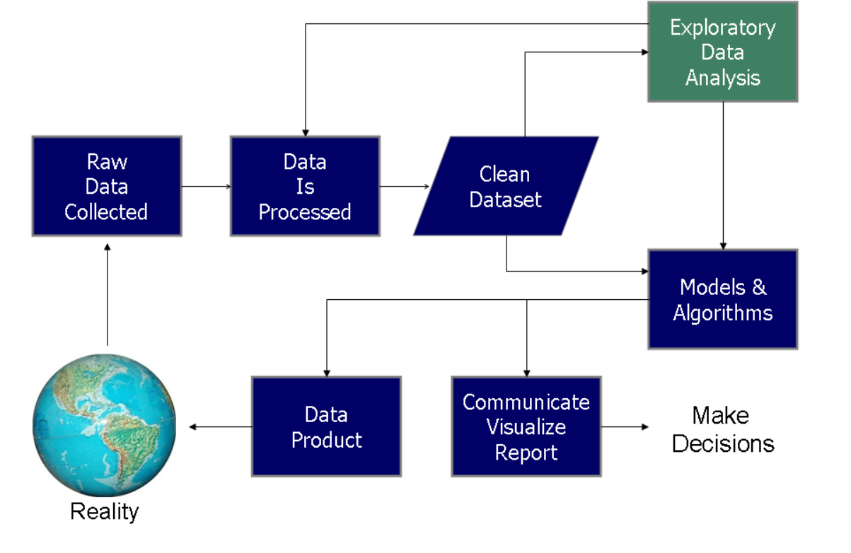
Data Science Process

Slide 5
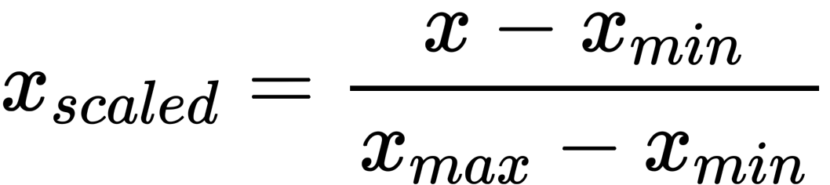
Data Preprocessing
To properly work with our data, we must clean it.
The Player names are normalized to remove unwanted characters
The Data had no missing values
Some outliers in the data was taken care by scaling the data using a min max scaler

Slide 6
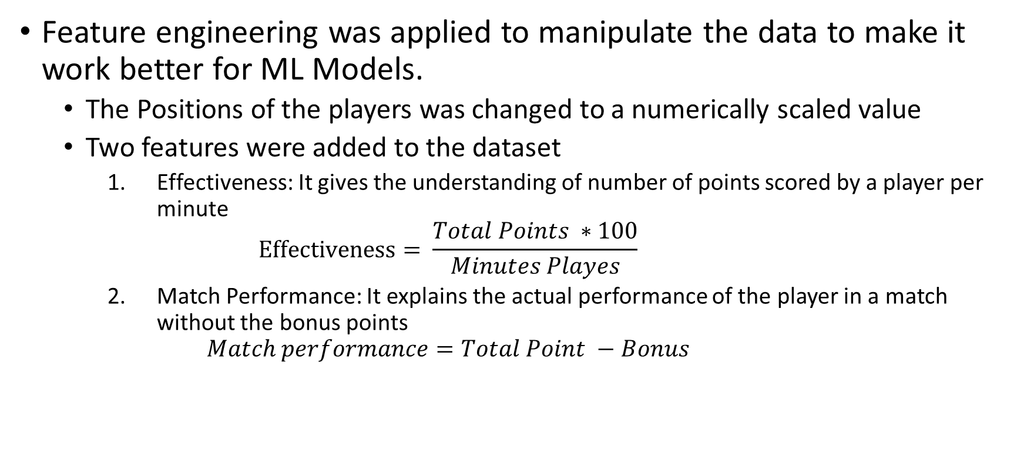
Feature engineering was applied to manipulate the data to make it work better for ML Models.
The Positions of the players was changed to a numerically scaled value
Two features were added to the dataset
Effectiveness: It gives the understanding of number of points scored by a player per minute $Effectiveness= \frac{Total Points ∗100}{Minutes Playes}$
Match Performance: It explains the actual performance of the player in a match without the bonus points $Match performance=Total Point −Bonus$

Slide 7
Exploratory Data Analysis(EDA)
EDA is an approach to analyze data to summarize their main characteristics
Usually visual methods are used
We perform analysis on data that we collected
To find important metrics/features
By using some nice and pretty visualizations

Slide 8
Exploratory Data Analysis(EDA)
EDA is majorly performed using two methods:
Univariate Analysis: Provides summary statistics for each field in the raw data set.
Bivariate Analysis: Performed to find the relationship between each variable in the dataset and the target variable of interest.
The Following plots were used for EDA
Pair Plot: It shows a clear and nice view of all variables and their relationship with all other variables
Scatter Plot: Plots different observation of the same variable corresponding to index

Slide 9
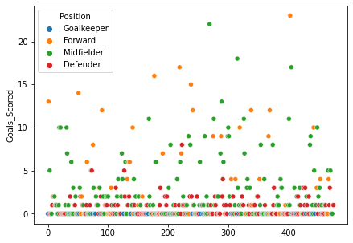
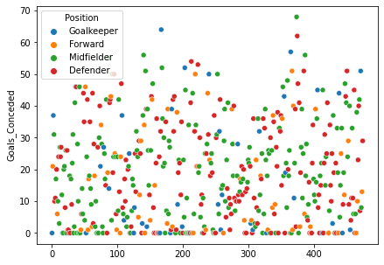
Univariate Analysis
From the graph, It can be seen that most goals are scored by forward and midfielder
Highest goal scorer is forward, while lowest is goalkeeper
From the graph, No pattern can be observed in no of goals conceded

Slide 10
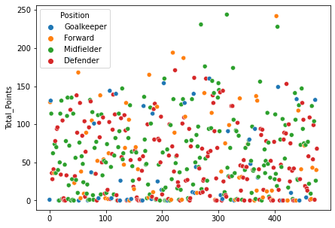
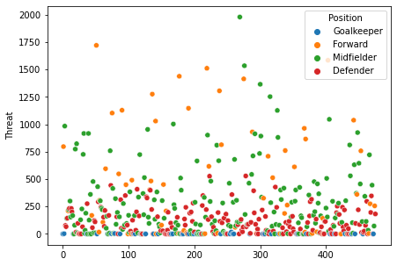
More than 150 points are obtained by midfielder and forward players, and below 150 there is a no particular pattern
Highest threat to other team is given by forward and midfielder
Defender also poses some threat but goalkeeper poses least threat

Slide 11
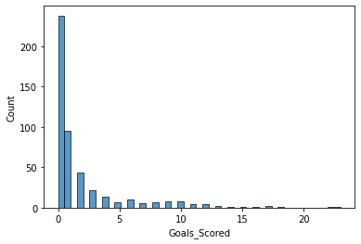
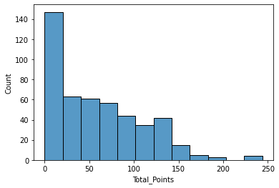
From the graph, It can be seen that most players have not scored any goal
Players scoring more that 10 goals are rare
From the graph, It can be seen that majority of players score between 0-150
Players scoring above 150 are rare

Slide 12
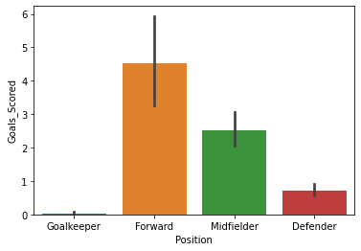
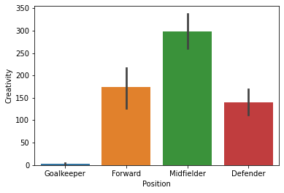
Bivariate Analysis
From the plot, it can be seen that most of the goals are scored by forward and midfielder
Goalkeeper scored nearly zero goal
Average goal scored by forward is 4.5
From the graph, It can be seen that midfielder shows most creativity as it produces opportunities for the forward players
Goal keeper shows least creativity in a match

Slide 13
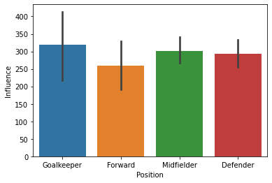
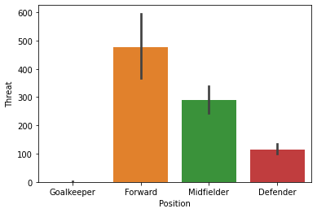
From the graph, It can be seen that influence of all the players are nearly equal but goalkeeper has most influence
From the graph, it can be seen that forward poses most threat as seen earlier too

Slide 14
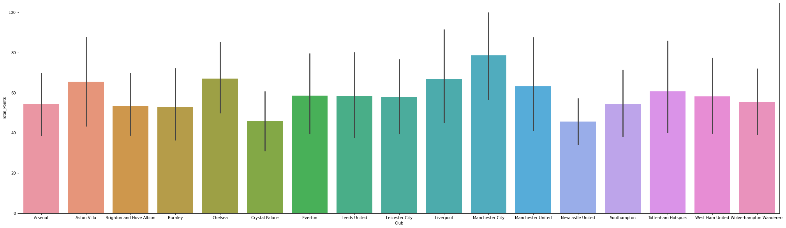
From the graph, total points scored by teams are nearly equal with Manchester city having highest points
Least points scored is by crystal palace

Slide 15
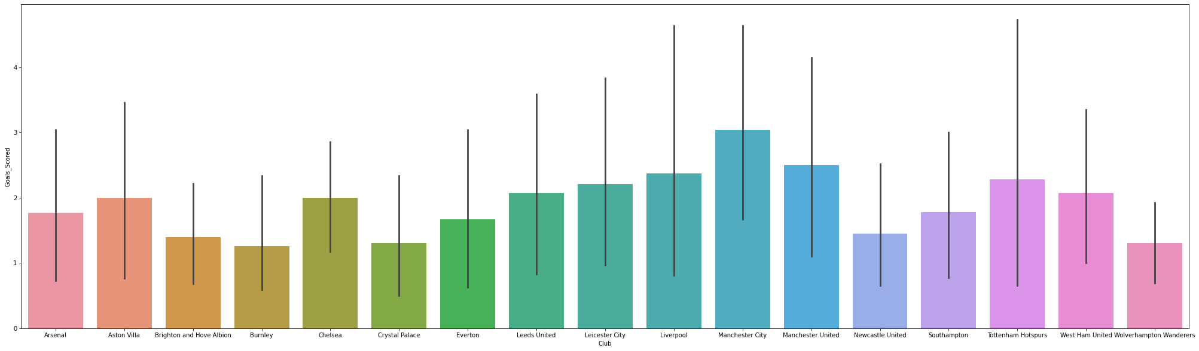
From the graph, total goals scored by teams are nearly equal with Manchester city having highest no. of goals
Tottenham hotspurs and Liverpool have some players which are really good scorers

Slide 16
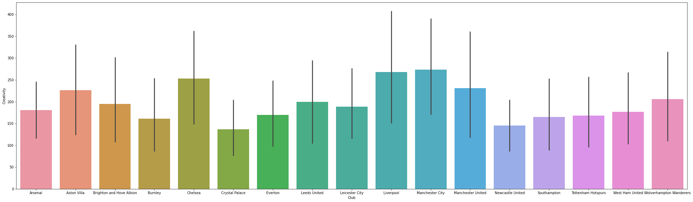
From the graph, it can be seen that Manchester city’s player have the highest influence in a match with crystal city being the least
Highest variance is seen in Liverpool team, meaning some player in Liverpool have very high influence in a match

Slide 17
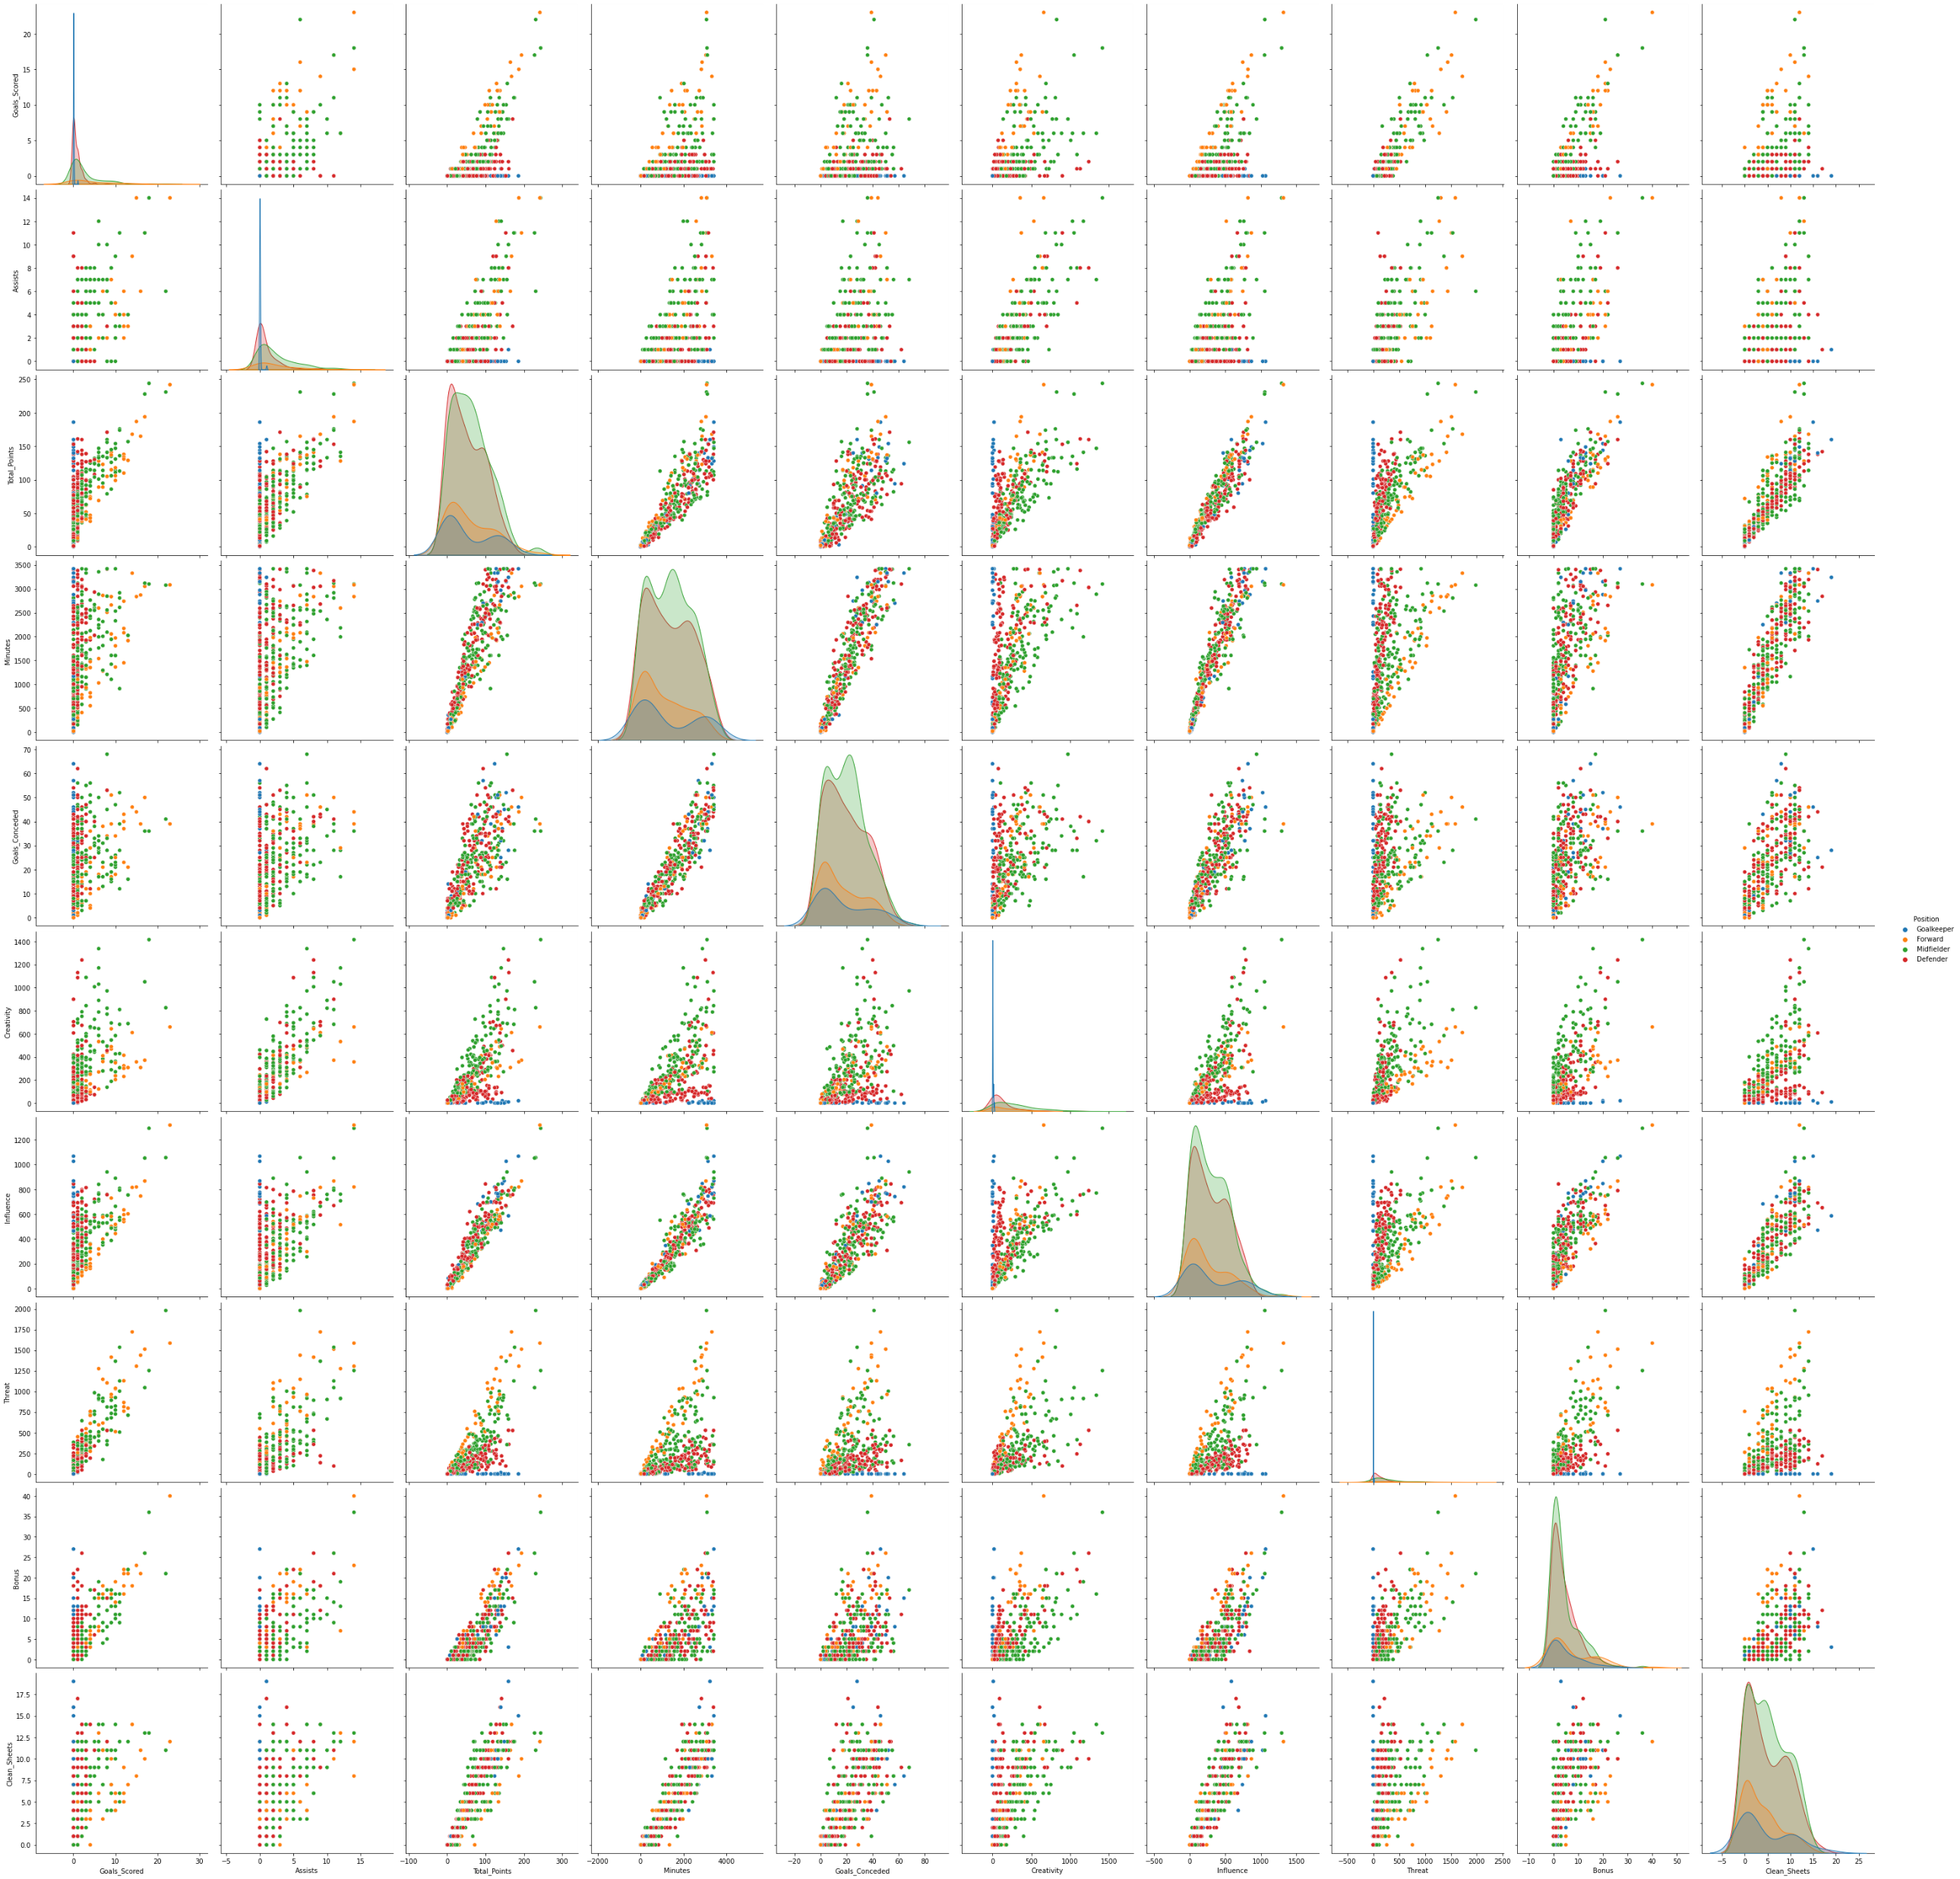
This figure shows scatter plots of every two variables used in our analysis

Slide 18
K-Means Clustering
The goal here is to group players based on a variety of scores
K-means clustering can be explained as:
We define the number of clusters which refers to the number of centroids
Data points are assigned to the clusters by reducing the in-cluster sum of squares.
Process repeats until clusters have been minimized.
In real world, we don’t know the number of clusters to be chosen
One way to determine the optimum number of groups is using elbow Method

Slide 19
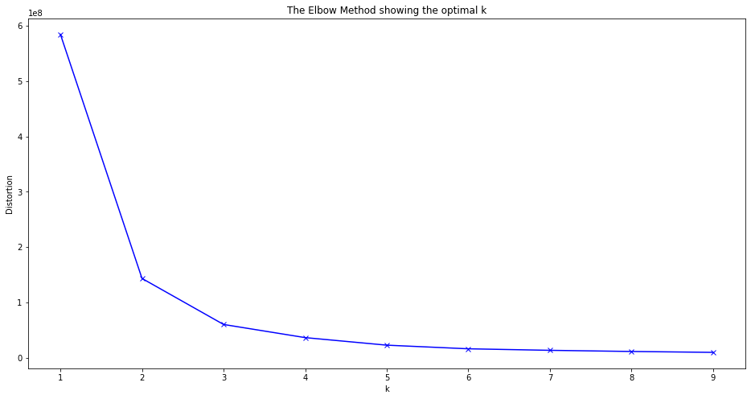
Elbow Curve
One way to determine the optimum number of groups is using elbow Method
It compares the in-cluster sum of squares across different centroid configurations

Slide 20
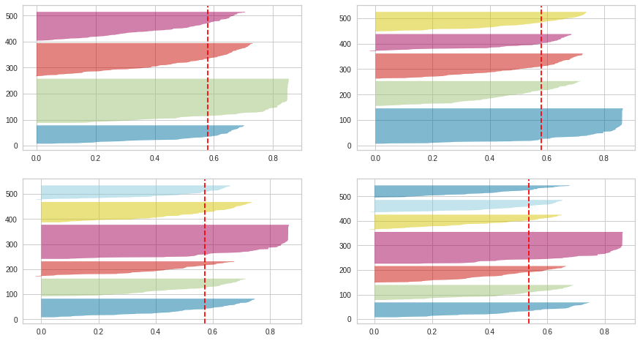
Silhouette Plot
It is a method to interpret and validate the consistency of the clustering algorithm
It provides a graphical representation of how well each object has been classified

Slide 21
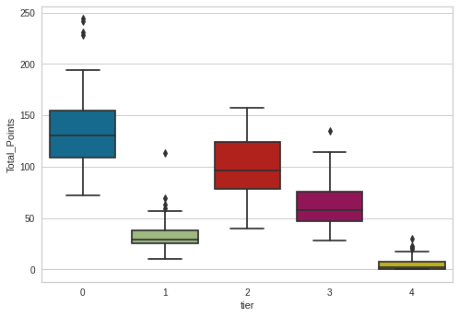
Optimal Number of Clusters
From the silhouette scores and Elbow curves the optimal number of clusters were chosen
The maximum silhouette score of 0.58 was obtained for 5 clusters
Fantasy Points scored by tier group

Slide 22
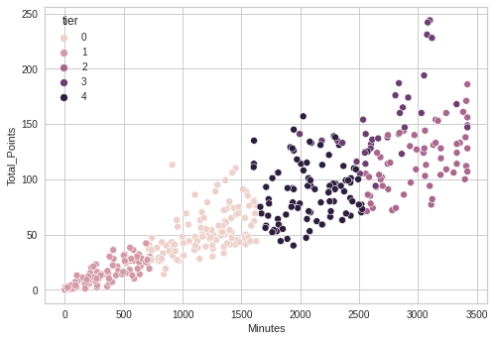
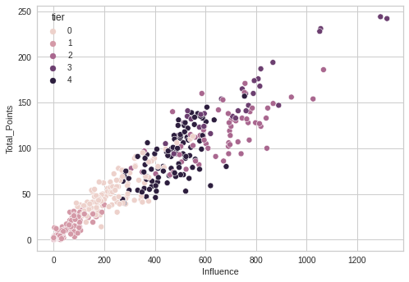
Cluster Profiling
5 Clear cluster can be seen which is consistent with both minutes played by a player and their influence in a match

Slide 23
Hierarchical Clustering
There are certain challenges with K-means
It always tries to make clusters of same size
The number of clusters need to be selected at start
Ideally, the number of clusters is not known at the start
This gap is bridged by hierarchical clustering.
Hierarchical clustering can be explained as:
It assigns each data point as a cluster
The most similar clusters are combined
This process is repeated until we have only one cluster

Slide 24
Linkages
During hierarchical clustering, two sub-cluster are combined
For that distance between them is required
The different linkage define the different approaches to measure the distance between them
Single – It returns the minimum distance between any two points in the clusters
Complete- It returns the maximum distance between any two points in the clusters
Average- It returns the average distance between all the points in the clusters

Slide 25
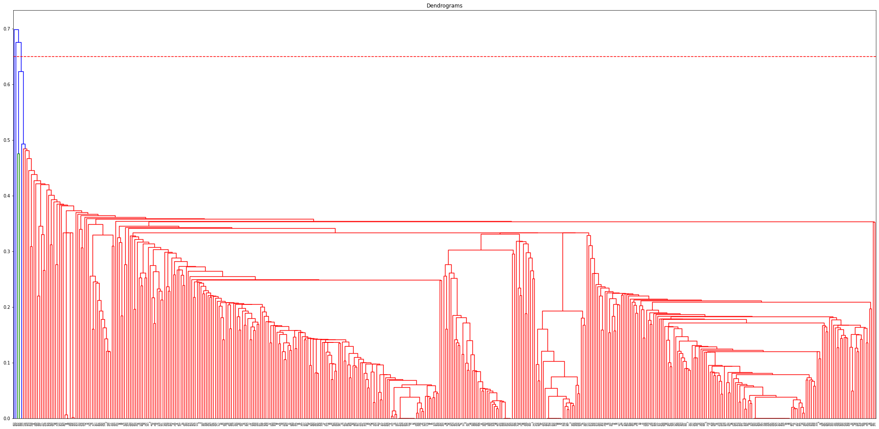
Single Linkage

Slide 26
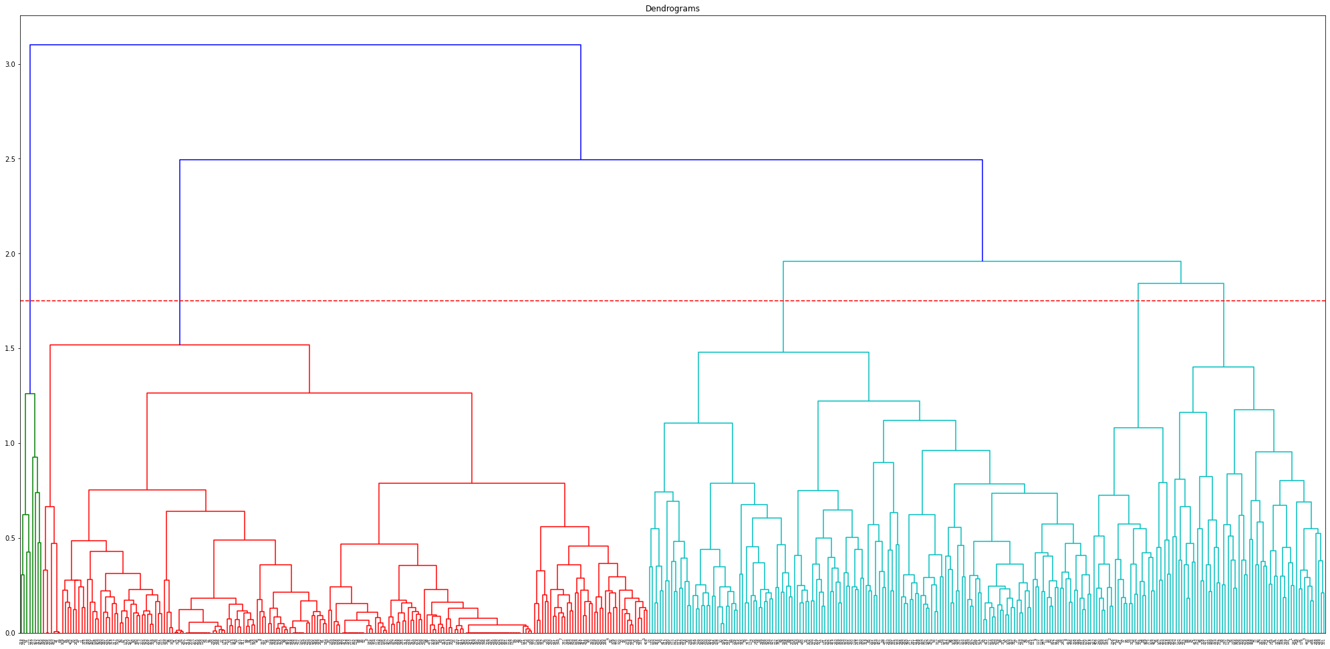
Complete Linkage

Slide 27
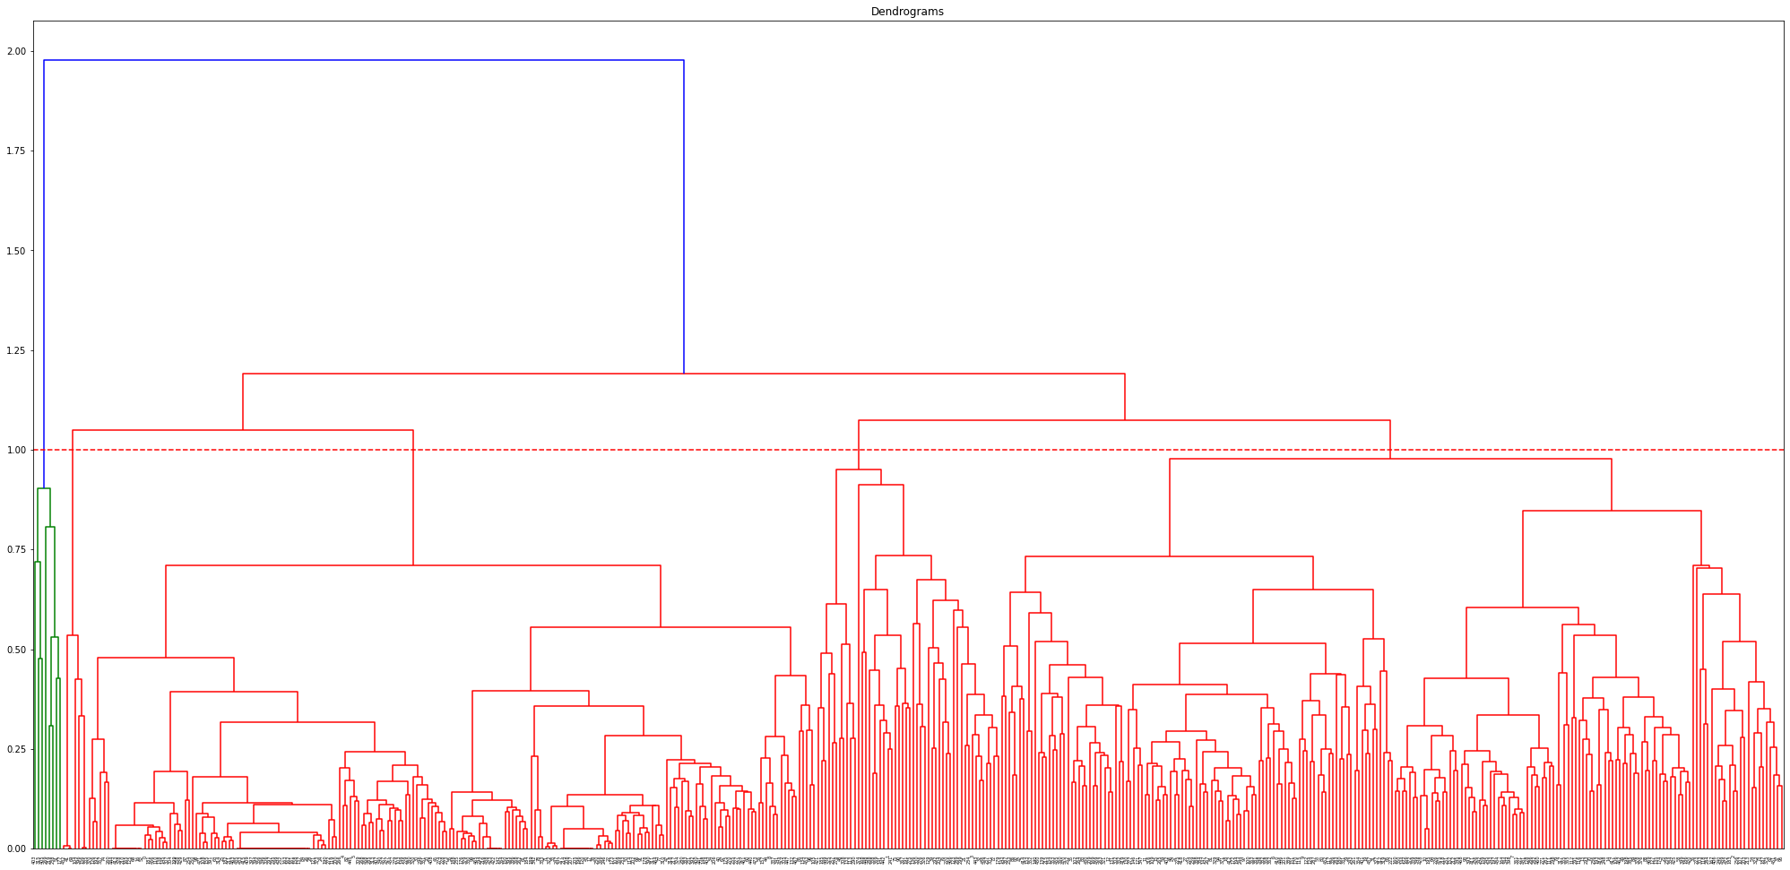
Average Linkage

Slide 28
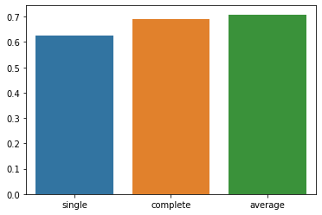
Cophenetic Correlation
Cophenet index is a measure of the correlation between the distance of points in feature space and distance on the dendrogram
Cophenet index of different Linkage Methods in hierarchical clustering

Slide 29
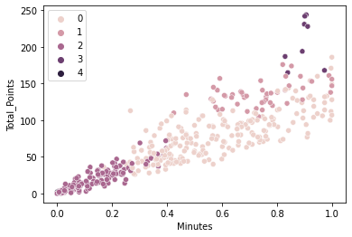
Optimal Hierarchical Clustering
The highest cophenet index was obtained for average linkage hence we use that.
Using the dendrogram plot for average linkage and threshold distance as 1.00 we got optimal number of clusters as 5
Scatter plot of total points versus minutes with 5 clusters

Slide 30
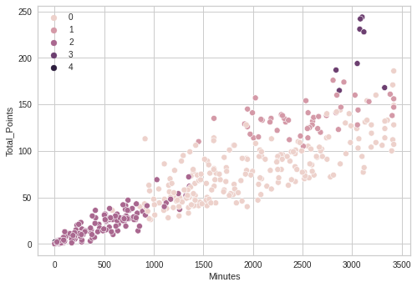
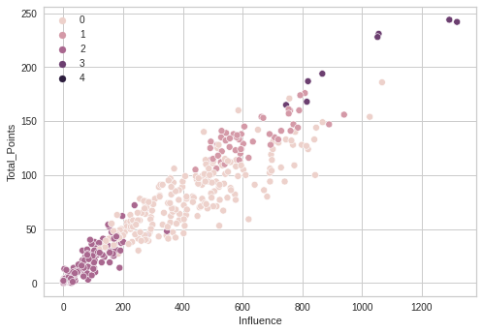
Cluster Profiling
5 Clear cluster can be seen which is consistent with both minutes played by a player and their influence in match

Slide 31
Comparing Clusters
Hierarchical Clustering
Kmeans Clustering
In hierarchical clustering the total number of points in a cluster in uneven as compared to kmeans clustering

Slide 32
Comparing Clusters
Hierarchical Clustering
Kmeans Clustering
In hierarchical clustering the clusters can be seen based on the total points scored by a player while in kmeans it depends more on influence of the player
In hierarchical clustering the clusters are formed with player potentials distributed in a range of 50

Slide 33
Key Takeaways
In view of scoring more goals the midfielder and forward players should be priced higher
Manchester City has the highest no of points, hence its players can be priced higher
Some players in Liverpool have very high influence in a match whom can be priced higher
Tottenham hotspurs and Liverpool have some players which are really good goal scorers

Slide 34
Key Takeaways
Hierarchical Clustering provides better way to cluster players based on their total points(potential)
A particular cluster of players should be priced nearly equal
Players in different cluster should be priced differently

